Slide 1
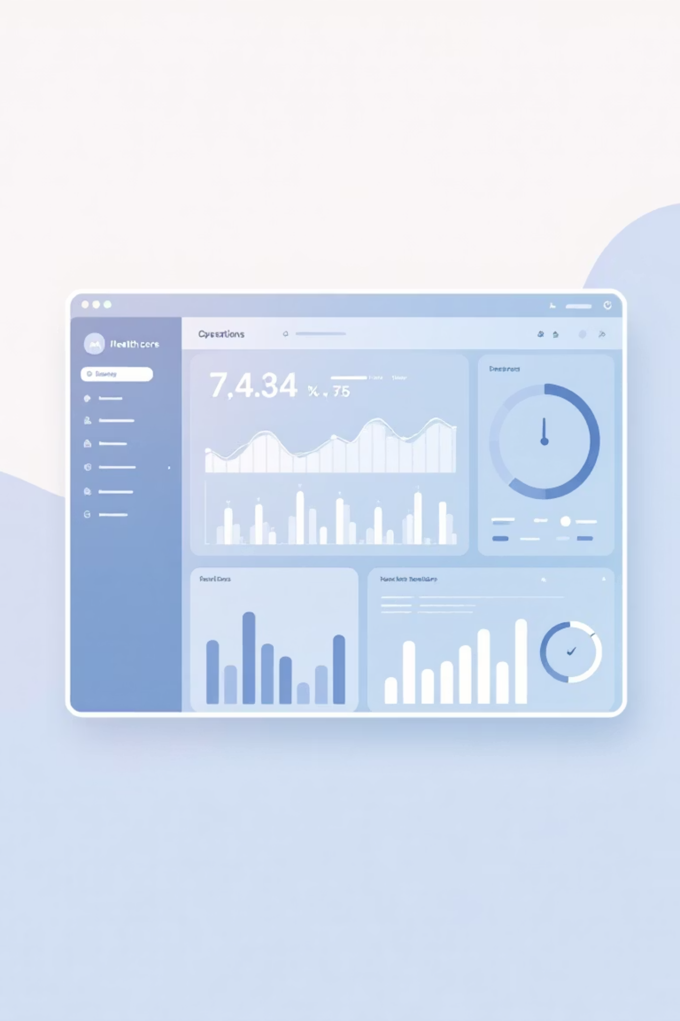

PULSE INDIA
AI Foresight and Resilient Care: An AI Agent for Proactive Healthcare Operations
A Presentation by Team Infinite Recursion

Slide 2


The Predictable Crisis India Faces Every Year
Festival Surges
AQI Crisis
Hospital visits spike significantly during major festivals like Diwali and Ganesh Chaturthi.
Air Quality Index (AQI) spikes drive a massive 46% increase in PM2.5 related emergency admissions.
These events are statistically predictable, yet resources are often not pre-positioned.
Peak concentrations can reach 603 µg/m³ (over 10x safe limits).
Health Impact
This seasonality leads to acute surges in respiratory, trauma, and burn cases.
This predictable bottleneck overwhelms infrastructure and personnel.
Reactive operations lead to compromised care, staff burnout, and severe resource strains when demand spikes.

Slide 3

Introducing Pulse India
The First Agentic AI for Indian Healthcare Operations
Pulse India is a generative AI system that translates multi-source intelligence into specific, time-bound action plans for hospital administrators.
1. Data Synthesis
2. AI Prediction
3. Action Plans
Ingest and fuse real-time data streams: AQI, social event calendars, epidemiological signals, and internal EMR history.
Utilize proprietary ML models (LSTM, Prophet) to generate highly accurate 1-4 week forecasts of specific demand by service line.
The Agentic Engine auto-generates prioritized, operational recommendations to pre-position resources and staff.
We don't just predict crises — we prevent them.

Slide 4


Comprehensive Data Intelligence
Our AI engine ingests and correlates a diverse set of structured and unstructured data to build a holistic predictive model.
Historical Records
Event Data
Past outbreaks and patterns
Festival calendars and gatherings
AI Predictive Engine
Epidemiological
Environmental Data
Case reports and transmission trends
Weather and air quality metrics
Event Data
Environmental Data
Epidemiological
Hospital Records
Festival calendars, political gatherings, large public events, and school holidays that impact trauma and general demand.
Real-time and forecasted AQI, temperature, humidity, and extreme weather alerts affecting respiratory and heat-related cases.
Regional health bulletins, outbreak signals, vaccination rates, and local disease surveillance data.
Cleaned and anonymized historical admission patterns, wait times, resource utilization, and patient demographics.

Slide 5
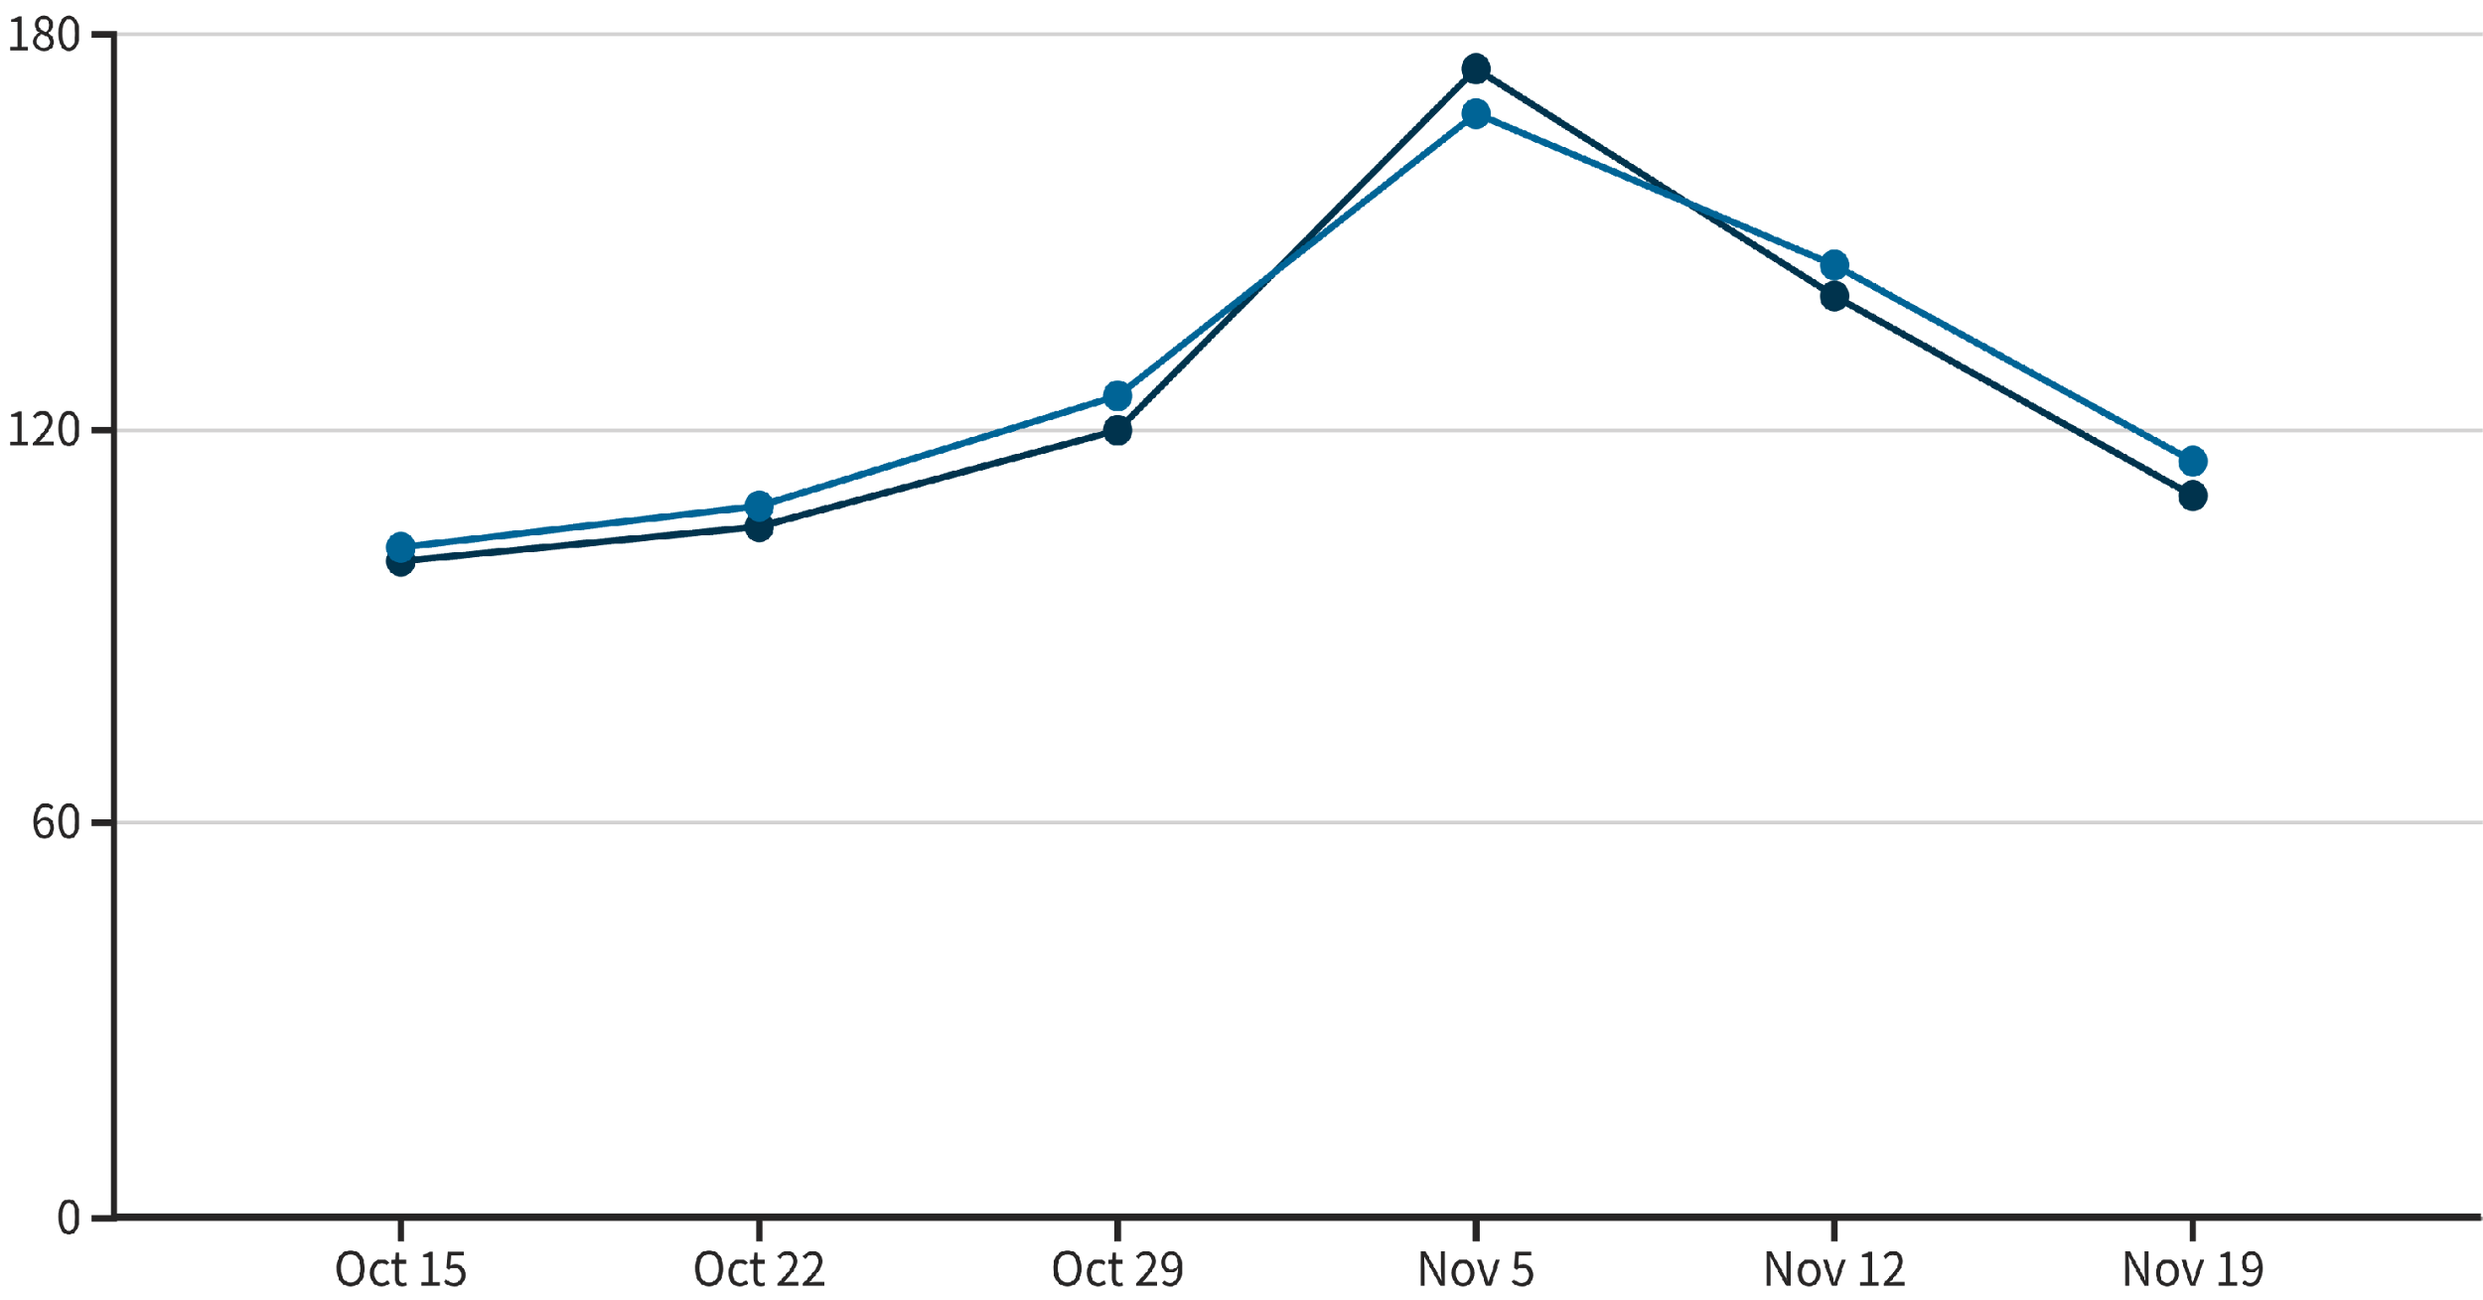
Forecasting with 92% Accuracy
Our models provide a clear, actionable picture of future demand, enabling two weeks of preparation time.
Actual Patient Load
Predicted Patient Load
Advance Warning
Example: Pulse India accurately predicts a 46% surge in respiratory cases between Oct 31 and Nov 5, 2024 (Diwali peak), giving administrators 14 days to adjust.
Built using robust models like LSTM (Long Short-Term Memory) for time-series forecasting and the Prophet algorithm for seasonality decomposition.

Slide 6
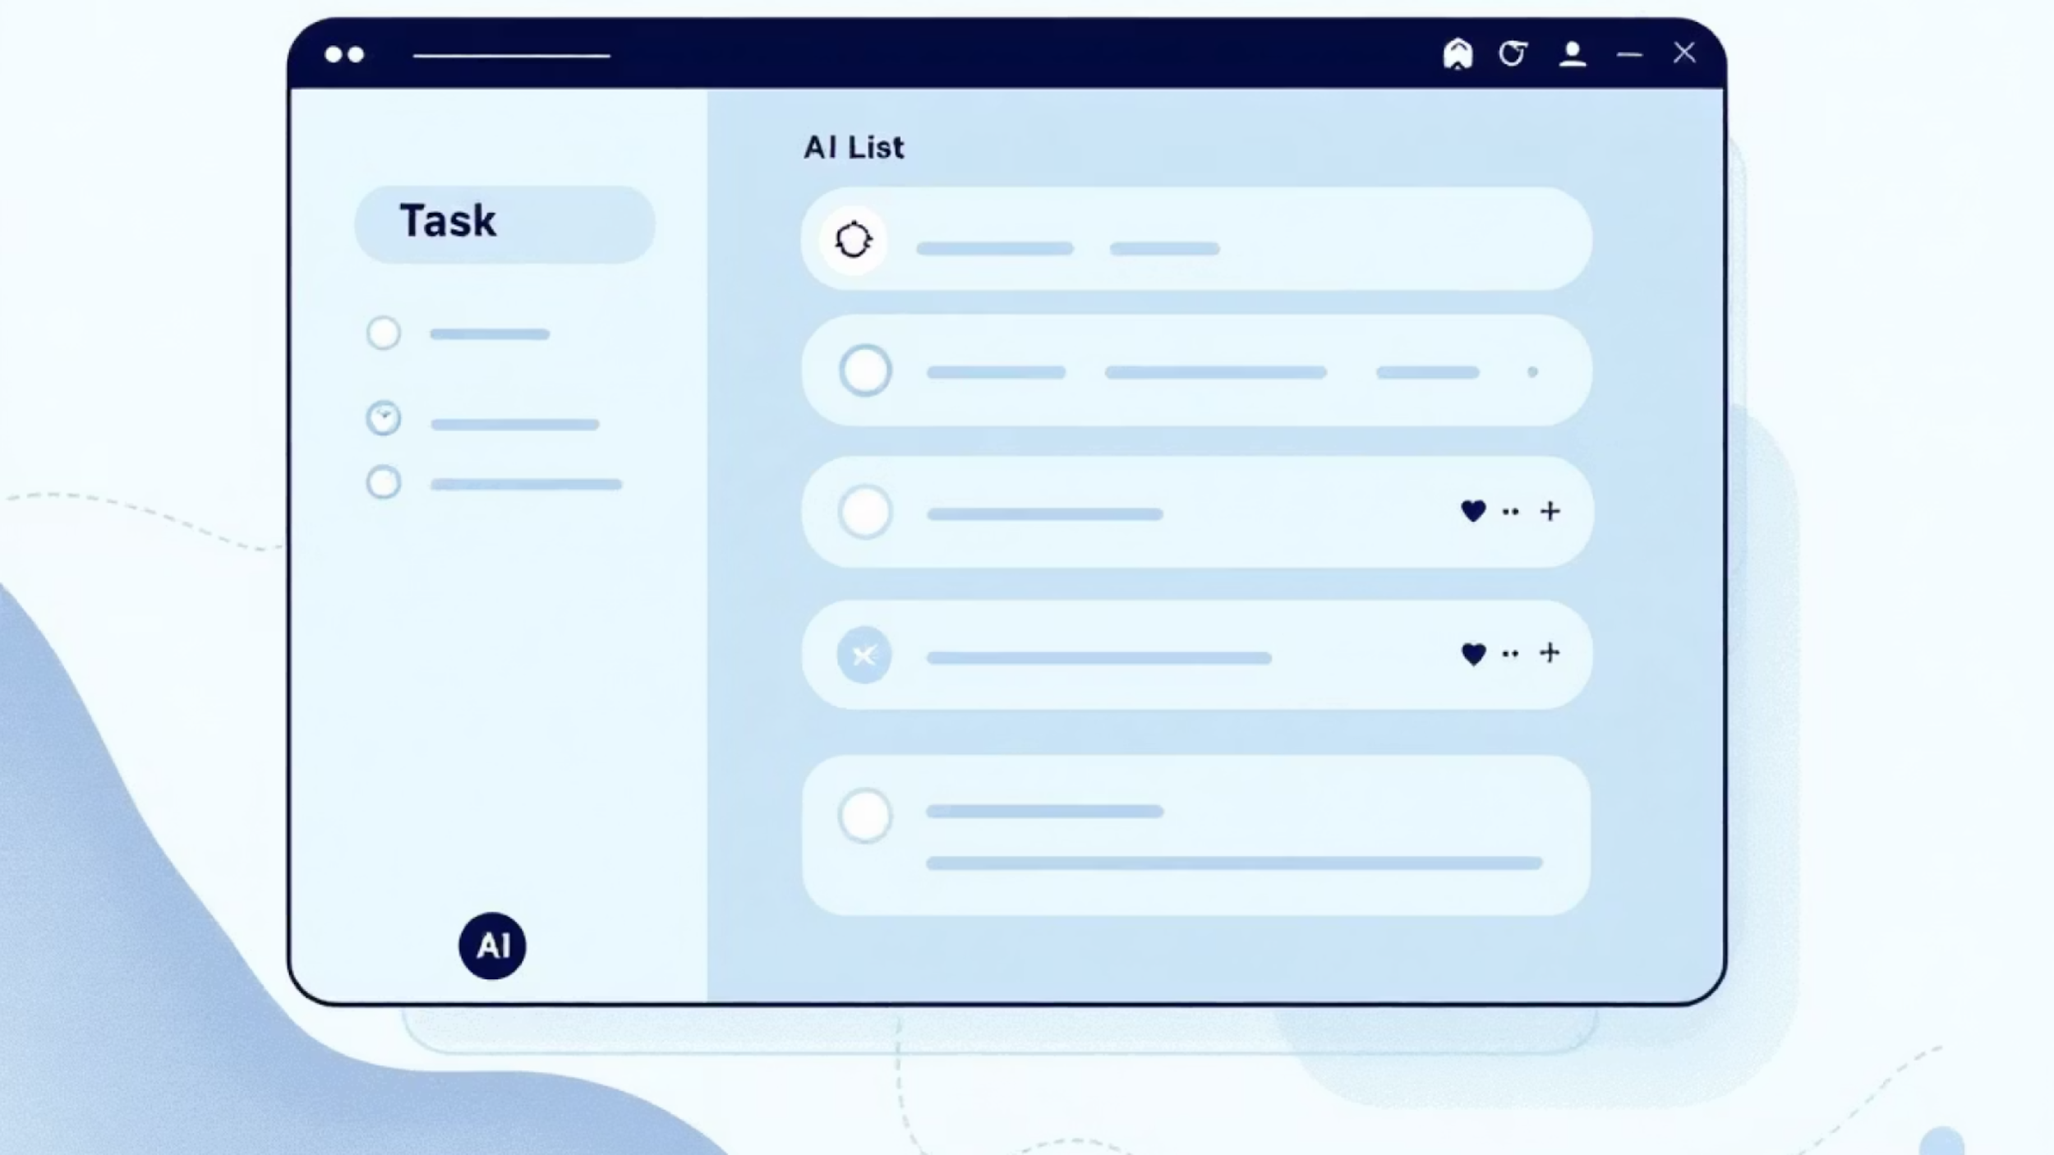




Beyond Prediction: Actionable Intelligence
Agentic Recommendations are Auto-Generated and Prioritized
CRITICAL
HIGH
MEDIUM
Staffing: Schedule 3 respiratory therapists + 5 ER nurses for Oct 31 – Nov 5, based on predicted shift-level demand.
Supply Chain: Order nebulizers & corticosteroids by Oct 25 to meet a predicted 88% demand increase in consumables.
Public Advisory: Launch targeted SMS campaign on firecracker safety and safe breathing practices in low-income areas.
Deadline: Oct 28
Deadline: Oct 25
Deadline: Oct 20
Impact: Reduces wait times by 30%
Impact: Eliminates critical resource shortages
Impact: Proactive demand reduction (estimated 5% fewer ER visits)

Slide 7

Built for Scale & Reliability
Pulse India System Architecture
Application Layer
Dashboard, Mobile Access, API Gateway for EMR Integration
Agentic Engine (LLM Reasoner)
Translates predictions into prioritized, cost-optimized, and time-bound operational commands (e.g., "Schedule 3 RNs").
AI/ML Core
Proprietary forecasting models (LSTM, Prophet) and large-scale data processing pipelines for high-velocity data.
Infrastructure & Security
Cloud-native deployment (GCP/AWS) with anonymized data storage (PostgreSQL) compliant with Indian data standards.
Data Sources
APIs (AQI, Weather, News), EMR/HIS systems, Public Health Feeds

Slide 8
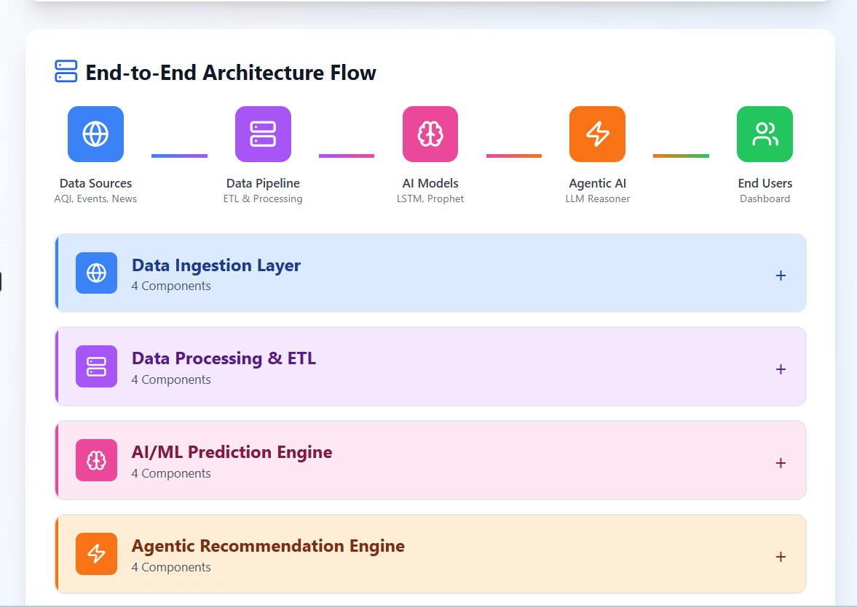
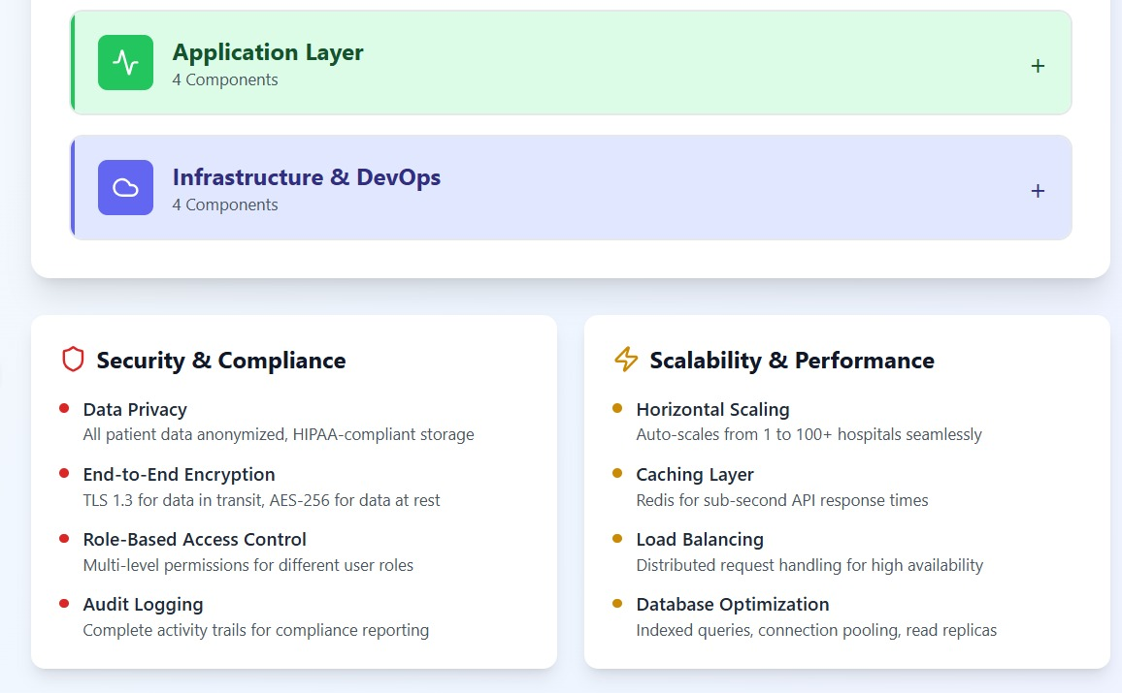

System Architecture

Slide 9



Working Prototype: Live Demo Available
Our Minimum Viable Product (MVP) is functional and ready for immediate pilot testing.
Key Features Demonstrated:
Interactive Prediction Graphs
Real-Time AQI Overlay
Prioritized Task Queue
Cost/Impact Simulations
Staffing Optimization Module
Functional MVP - Ready for Pilot
Scan the code below or visit our demo link to explore the interactive dashboard:

Slide 10
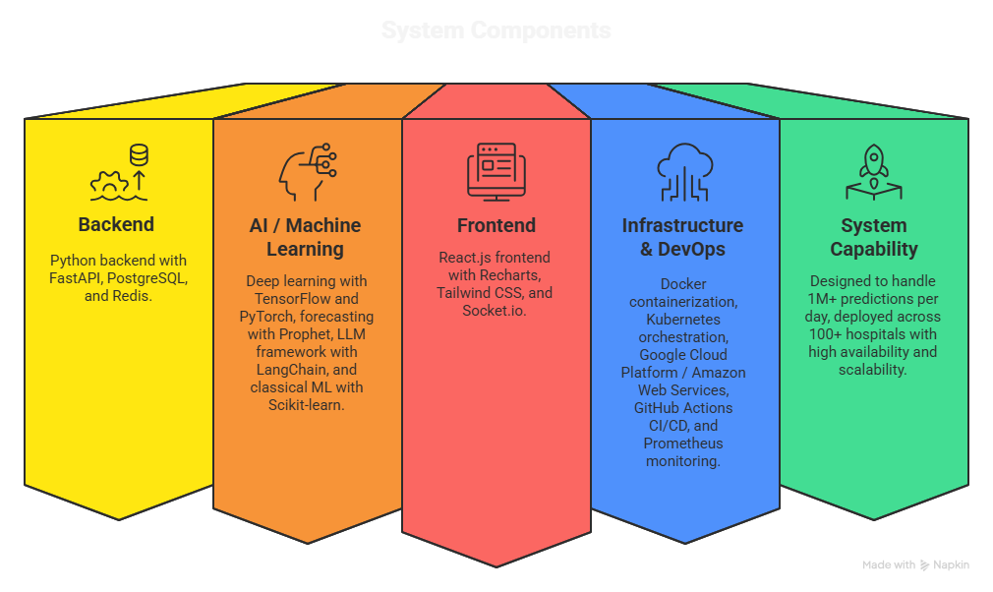

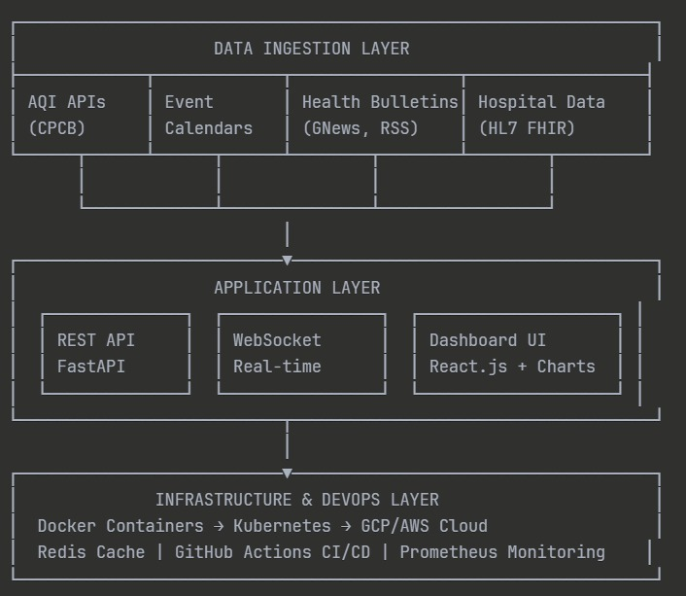


Technical Stack

Slide 11




Proven Value, Measurable Impact
Validation metrics confirm the system's accuracy and projected operational savings for a typical 500-bed facility.
Validation Metrics
Projected Operational Impact
92% Prediction Accuracy
40%
25%
Consistently validated against 3 years of historical admissions data and actual seasonal patterns.
Resource Reduction
Staff Overtime Savings
Reduced incidence of critical resource shortages (beds, ICU slots, specialized staff).
Optimized scheduling reduces unplanned, expensive staff overtime hours.
14 Days Advance Warning
Providing two full weeks for proactive resource re-allocation, staffing, and supply orders.
₹50L+
Diwali Pattern Test
Annual Cost Savings
Successfully validated against the challenging actual surge patterns observed in 2022 and 2023.
Projected savings per 500-bed hospital through efficiency gains and reduced waste.

Slide 12
Roadmap & Partnership Ask
We are poised for immediate deployment and seeking strategic partners to scale the solution.
Week 1-4
Week 9-12
MVP Development
Expansion Phase 1
Functional AI Agent and Dashboard Complete.
Scale deployment to 5 hospitals in the Delhi NCR region.
1
2
3
4
Week 5-8
Month 4-6
Pilot Hospital Launch
Regional Scale-Up
Integrate and test live at 1 Delhi hospital during Diwali 2024 surge.
Target 25 hospitals across 5 major Indian cities.
Our Ask
Strategic partnership with 1 pilot hospital for immediate integration.
Access to anonymized historical patient data for localization and model fine-tuning.
Support for integration with state-level public health and government API feeds.

Slide 13

References & Data Sources
A list of the core academic, regulatory, and technological foundations underpinning our predictive model and research methodology.
Academic & Regulatory Sources
Technical & Data Infrastructure
Central Pollution Control Board (CPCB): Air Quality Index Data and National Standards (cpcb.nic.in)
APIs & Real-Time Data:
CPCB Air Quality API: Used for real-time AQI monitoring across over 100 cities for live model input.
Times of India (2023, 2024): Cited documentation on Delhi's Post-Diwali AQI surge (42-46% increase), with PM2.5 peaks reaching 603 µg/m³.
GNews API: Employed for health bulletin aggregation and early outbreak signal detection from diverse news sources.
National Health Portal, MoHFW: Seasonal Disease Patterns & Epidemiological Data for regional health trends (nhp.gov.in)
HL7 FHIR Standard: Adhered to for seamless, secure integration of complex hospital data protocols (hl7.org/fhir).
IDSP – Integrated Disease Surveillance Programme: Official system for tracking epidemic outbreaks and public health risks.
Machine Learning Frameworks:
AIIMS Delhi Research Papers: Insights into hospital admission patterns and documented respiratory case surges during peak pollution events.
TensorFlow (Google, 2023): Implementation of LSTM models for robust time-series forecasting of health metrics.
Facebook Prophet: Utilized for advanced time-series decomposition and seasonal forecasting.
LangChain: Agentic AI framework used for dynamic data processing and automated analysis workflows.
Acknowledgments
We extend our gratitude to the hospital administrators for their crucial support during user research, the open-source community for providing powerful ML frameworks, and the Mumbai Hacks 2025 organizing committee.

